Slide 1
Head for the Future Ι Geoff Barton Ι Head, King Edward VI School, Suffolk
Download this presentation Ι www.geoffbarton.co.uk/teacher-resources (66)
Tuesday, December 1, 2009

Slide 2
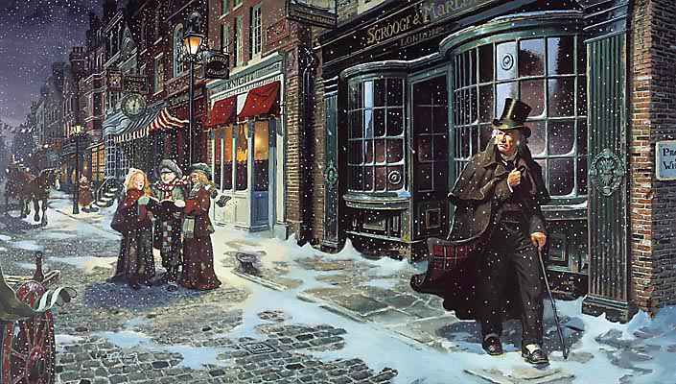

Slide 3
EDUCATIONPAST

Slide 4
EDUCATIONPRESENT

Slide 5
EDUCATIONFUTURE

Slide 6
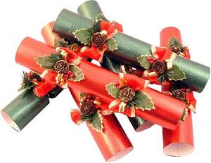
Education’s Crackers
Head for the Future Ι Geoff Barton Ι Head, King Edward VI School, Suffolk
Download this presentation Ι www.geoffbarton.co.uk/teacher-resources (66)
Tuesday, December 1, 2009

Slide 7
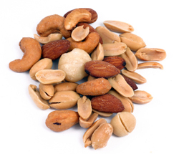
Education’s Nuts
Head for the Future Ι Geoff Barton Ι Head, King Edward VI School, Suffolk
Download this presentation Ι www.geoffbarton.co.uk/teacher-resources (66)

Slide 8
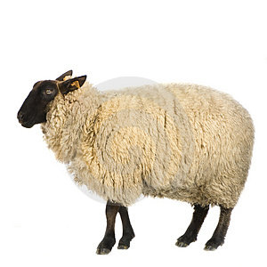
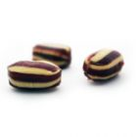
Baaaa Humbug

Slide 10
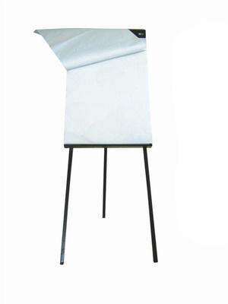

Slide 11
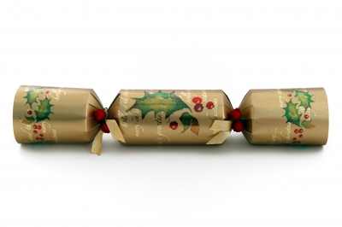

Slide 12
PAST

Slide 13
PRESENT

Slide 14
FUTURE

Slide 15
PAST

Slide 16
“If we do what we’ve always done, we’ll get what we’ve always got”
Bill Clinton

Slide 17
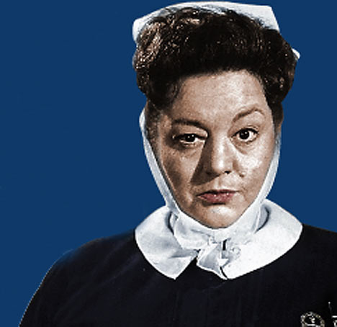

Slide 18
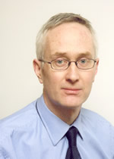
Michael Barber

Slide 19
Literacy standards in England
11945
1997

Slide 20
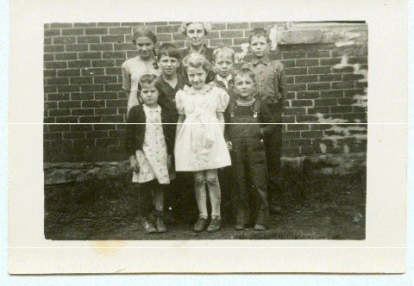

Slide 21
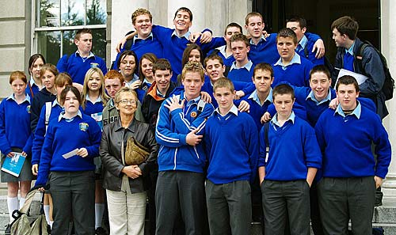

Slide 22
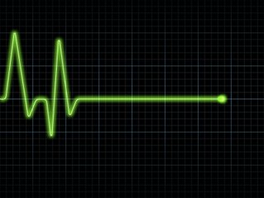

Slide 23
Beacon Schools
Training Schools
Coasting Schools
Super Heads
Consultant Heads
Executive Heads
Schools are becoming immune to school improvement
London Challenge
National Challenge
National Strategies
Leading Edge
Consultants
School improvement partners
Gaining Ground
Leading Light Schools
Trust Schools

Slide 24
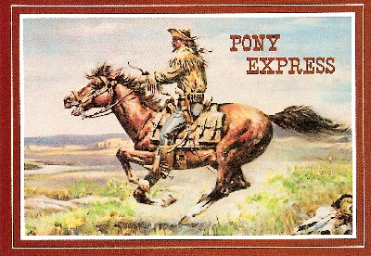

Slide 25
The Literacy
Club

Slide 26
DOGS MUST BE CARRIED ON THE ESCALATOR

Slide 27
Please don't smoke and live a more healthy life
PSHE Poster

Slide 28
Sign at Suffolk hospital:
Criminals operate in this area

Slide 29
Churchdown parish magazine:
‘Would the congregation please note that the bowl at the back of the church labelled “for the sick” is for monetary donations only’

Slide 30
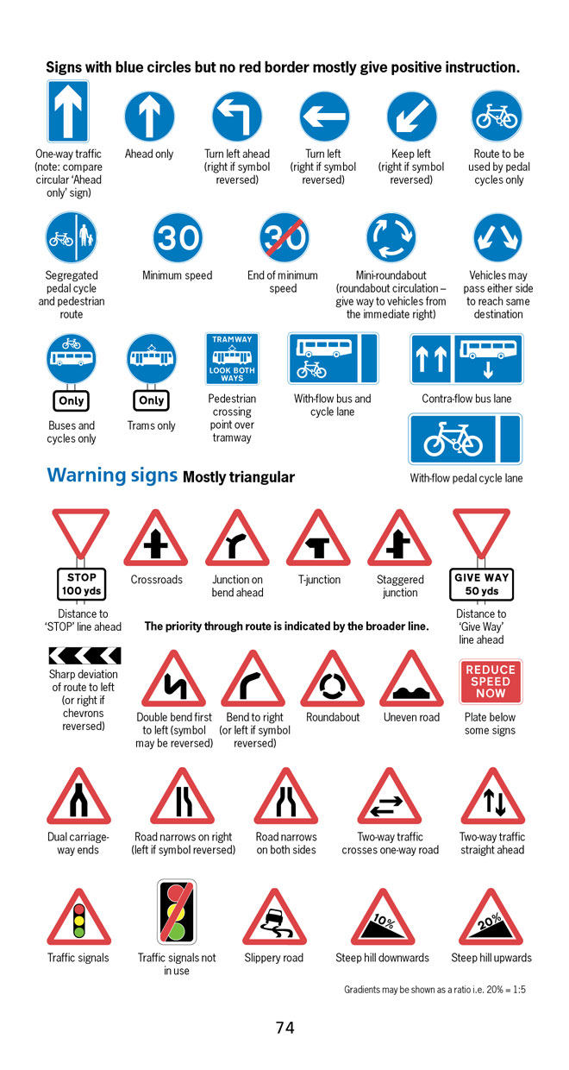
BBC NEWS ONLINE:
More than half of British motorists cannot interpret road signs properly, according to a survey by the Royal Automobile Club.
The survey of 500 motorists highlighted just how many people are still grappling with it.

Slide 31
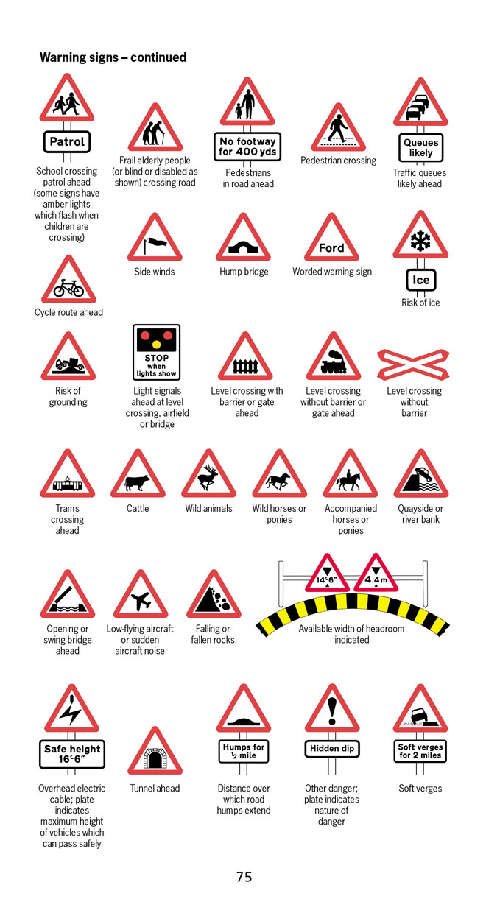
According to the survey, three in five motorists thought a "be aware of cattle" warning sign indicated …
an area infected with foot-and-mouth disease.

Slide 32
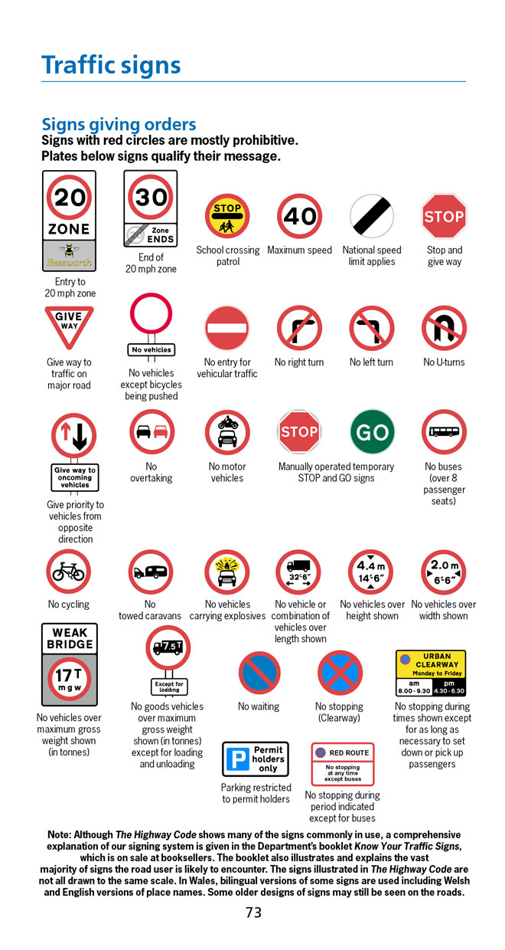
Common mistakes:
No motor vehicles - Beware of fast motorbikes
Wild fowl - Puddles in the road
Riding school close by - "Marlborough country" advert

Slide 33
“If we do what we’ve always done, we’ll get what we’ve always got”
Bill Clinton

Slide 34
PRESENT

Slide 35
“I’m mad as hell and I’m not going to take this any more”
Howard Beale aka
Peter Finch
in “Network”

Slide 36
Reject orthodoxies – eg the monster of safeguarding
Think air-traffic control
For some students the problem is the teacher: think beyond teachers
Exploit quick-hits, but hold on to the long-term goals
Dismantle subject bunkers and teach the skills students need – eg not FOFO

Slide 37
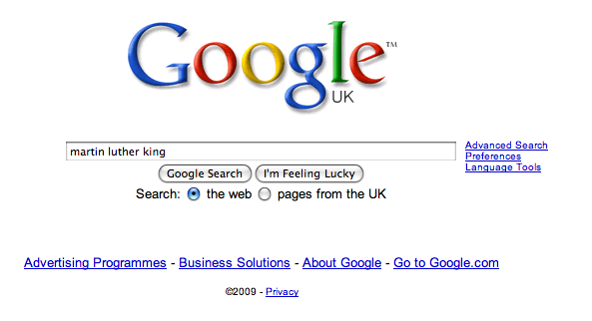

Slide 45
“I’m mad as hell and I’m not going to take this any more”
Howard Beale aka
Peter Finch
in “Network”

Slide 46
FUTURE

Slide 47
“To a worm in horseradish, the world tastes of horseradish”
Yiddish Proverb

Slide 48
Re-think the profession: fewer teachers, more “para-professionals”
School as community employment hub
Changing role of teacher
Focus relentlessly on training and developing great teachers: “micro-skills”
Focus relentlessly on training and developing great leaders: “judgment over experience”

Slide 49
“To a worm in horseradish, the world tastes of horseradish”
Yiddish Proverb

Slide 51
EDUCATIONPAST

Slide 52
EDUCATIONPRESENT

Slide 53
EDUCATIONFUTURE

Slide 54
Let’s do something different …
Head for the Future Ι Geoff Barton Ι Head, King Edward VI School, Suffolk
Download this presentation Ι www.geoffbarton.co.uk/teacher-resources (66)
Tuesday, December 1, 2009

Slide 55
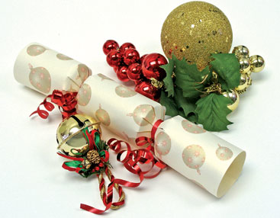

Slide 56
